Slide 1


PASS Insights
August, 2019
Newsletter
Hiram Fleitas
Fleitas Arts
github.com/hfleitas/rig
Notes:
Image ref: https://talesofarcadia.fandom.com/wiki/Toby_Domzalski

Slide 2
Get Cognitive API
By Using Python & T-SQL
Azure Cognitive Text Analytics
SQL Server In-DB ML Services
Python + T-SQL
Realtime Scoring
Hiram Fleitas
Fleitas Arts
github.com/hfleitas/SentimentPrediction
Notes:
Image ref: https://talesofarcadia.fandom.com/wiki/Toby_Domzalski

Slide 3











Hiram Fleitas
Owner Fleitas Arts
Bio
Father
Principal DB Architect
Python since 2009
Developer since 1995
SQL Server since 1999
USCG Auxiliary Flotilla Staff Officer
@hiramfleitas
/hfleitas
hiram@fleitasarts.com
hiramfletias
fleitasarts.com

Slide 4

DEMO
Notebook

Slide 5
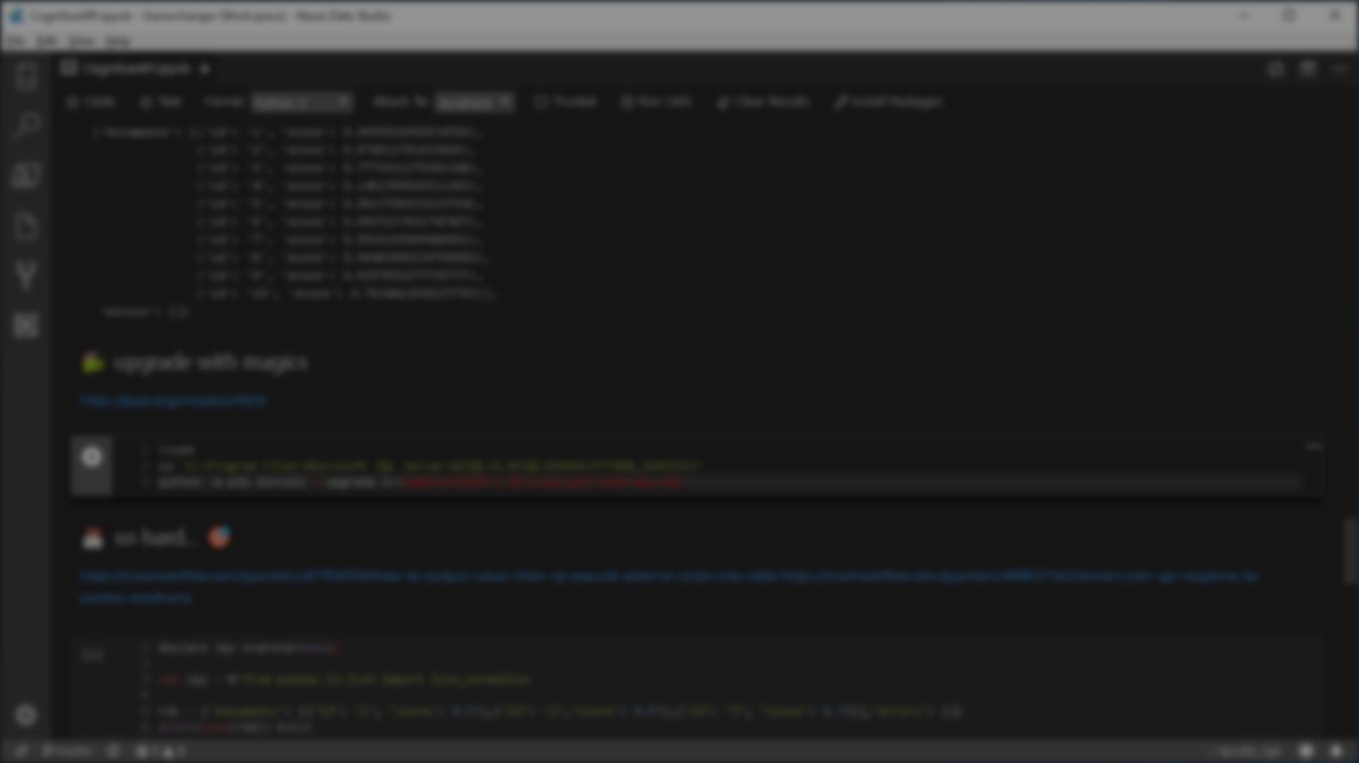


Summary
Azure Data Studio
Azure Cognitive Text Analytics API
JSON View
Training and Testing View
Models table
GetTrollhunterModel stored procedure
sp_RxPredict
Resources

Slide 6
Resources
http://fleitasarts.com
github.com/hfleitas/SentimentPrediction
netflix.com/trollhunters
pass.org/summit
Notes:
Image ref: https://talesofarcadia.fandom.com/wiki/Toby_Domzalski

Slide 7
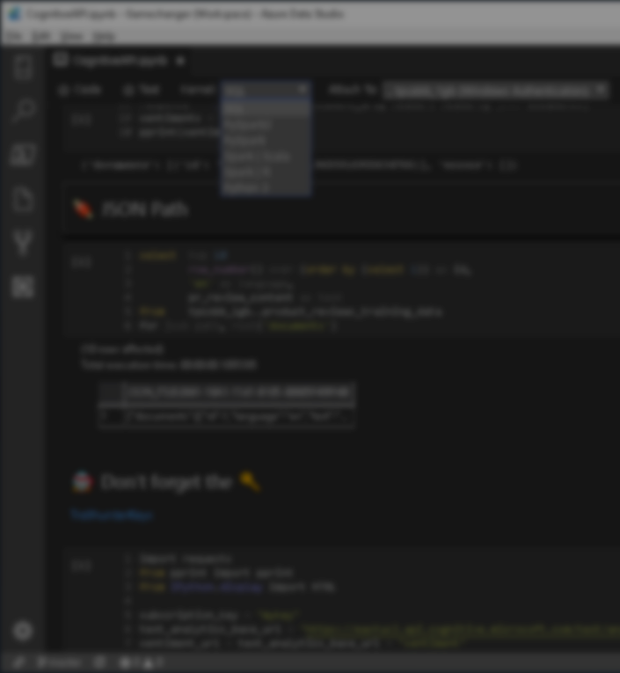

Session evaluations
This is the link:
bit.ly/Troll19
Your feedback is very important.
Submit your feedback by the end of this presentation.

Slide 8
Hiram Fleitas
Owner Fleitas Arts
@hiramfleitas
Thank You
hiram@fleitasarts.com
fleitasarts.com
/hfleitas
hiramfleitas

